Slide 1


Necro Nursery
Team Abra-cadaver

Slide 2
Narrative
Making World Bible
NPC Dialogue
Brainstormed minigames
Butcher Shop
Morgue
Glyph Carving

Slide 3

Audio
Started work on sound effects for UI, Monsters, Speaking, and Morgue minigame
Music soundtracks for all current scenes and morgue inigame
Main menu
Graveyard theme
Market theme
Ambience for whatever we need
Morgue Minigame

Slide 4
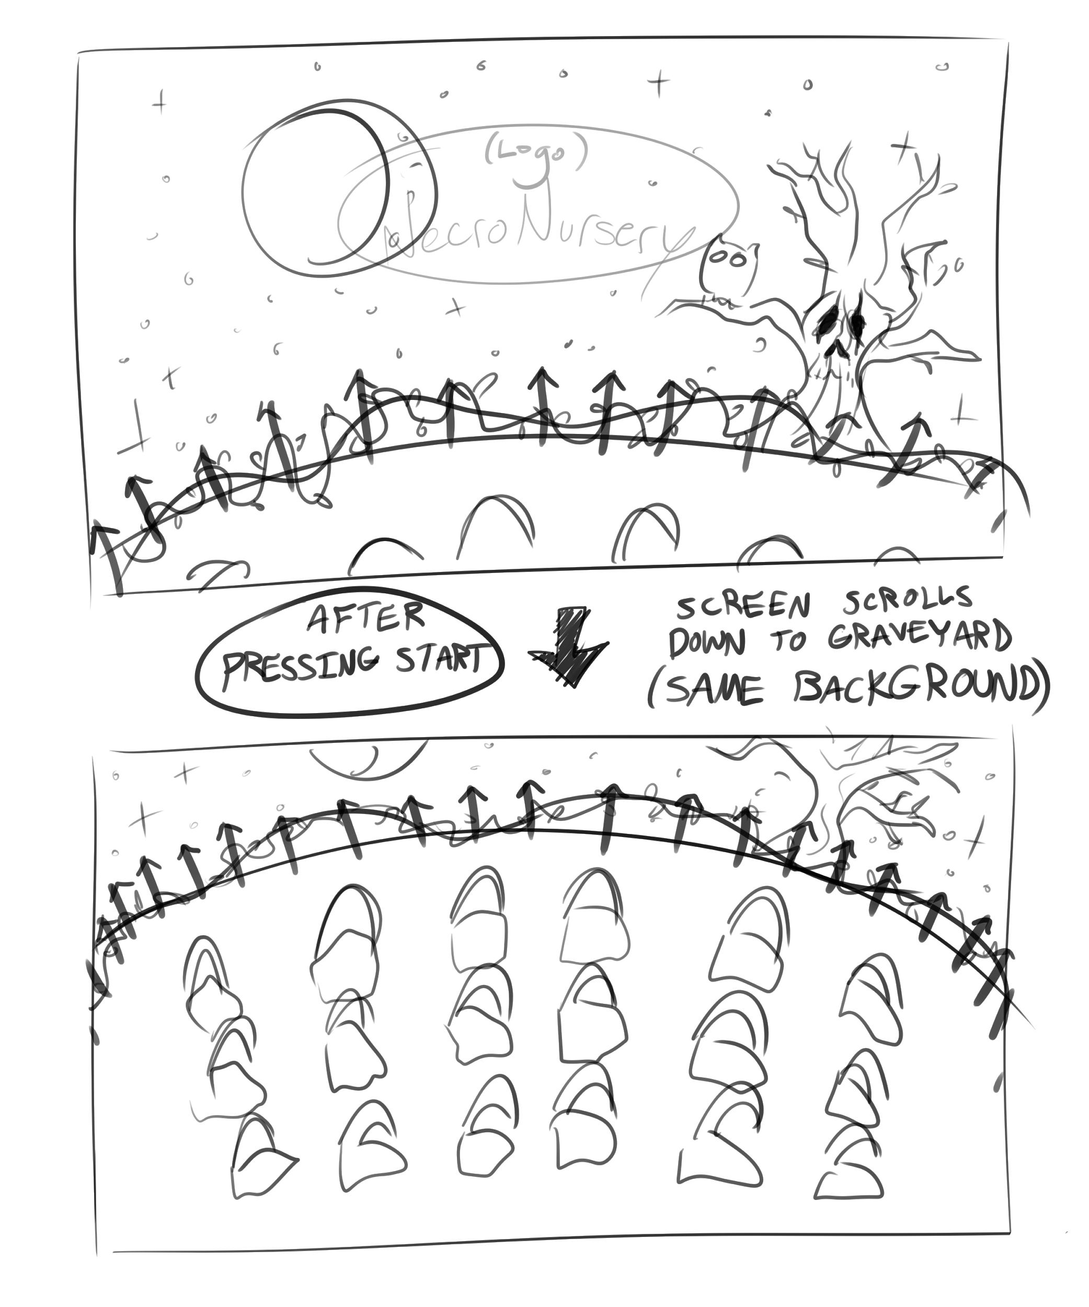
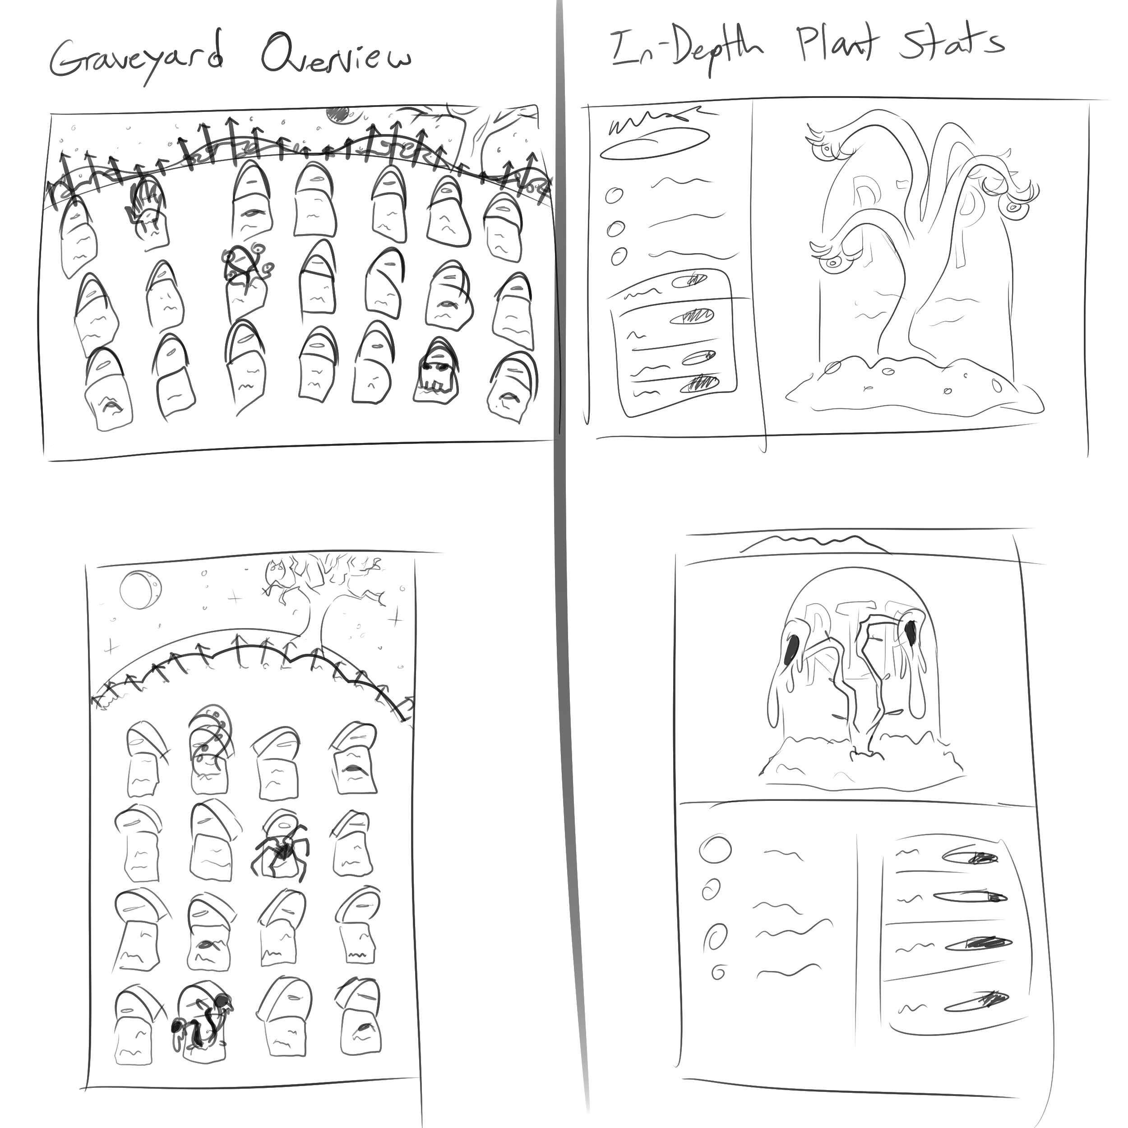
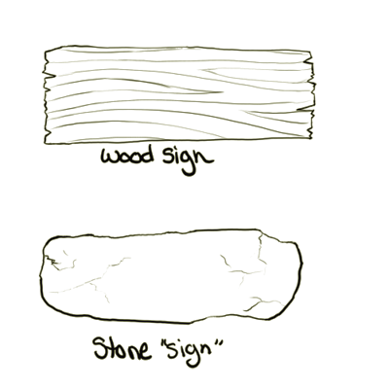
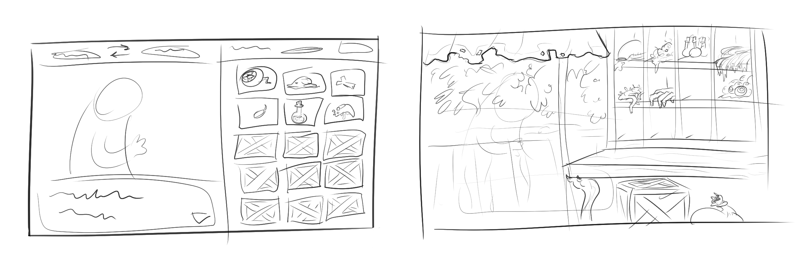
Title Screen Concept
Graveyard Concept
UI Concept
Shop Concept

Slide 5
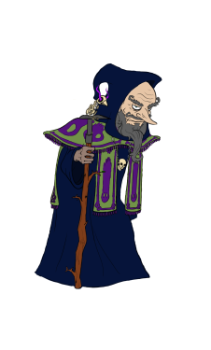
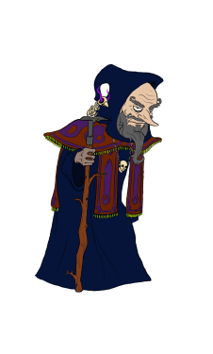
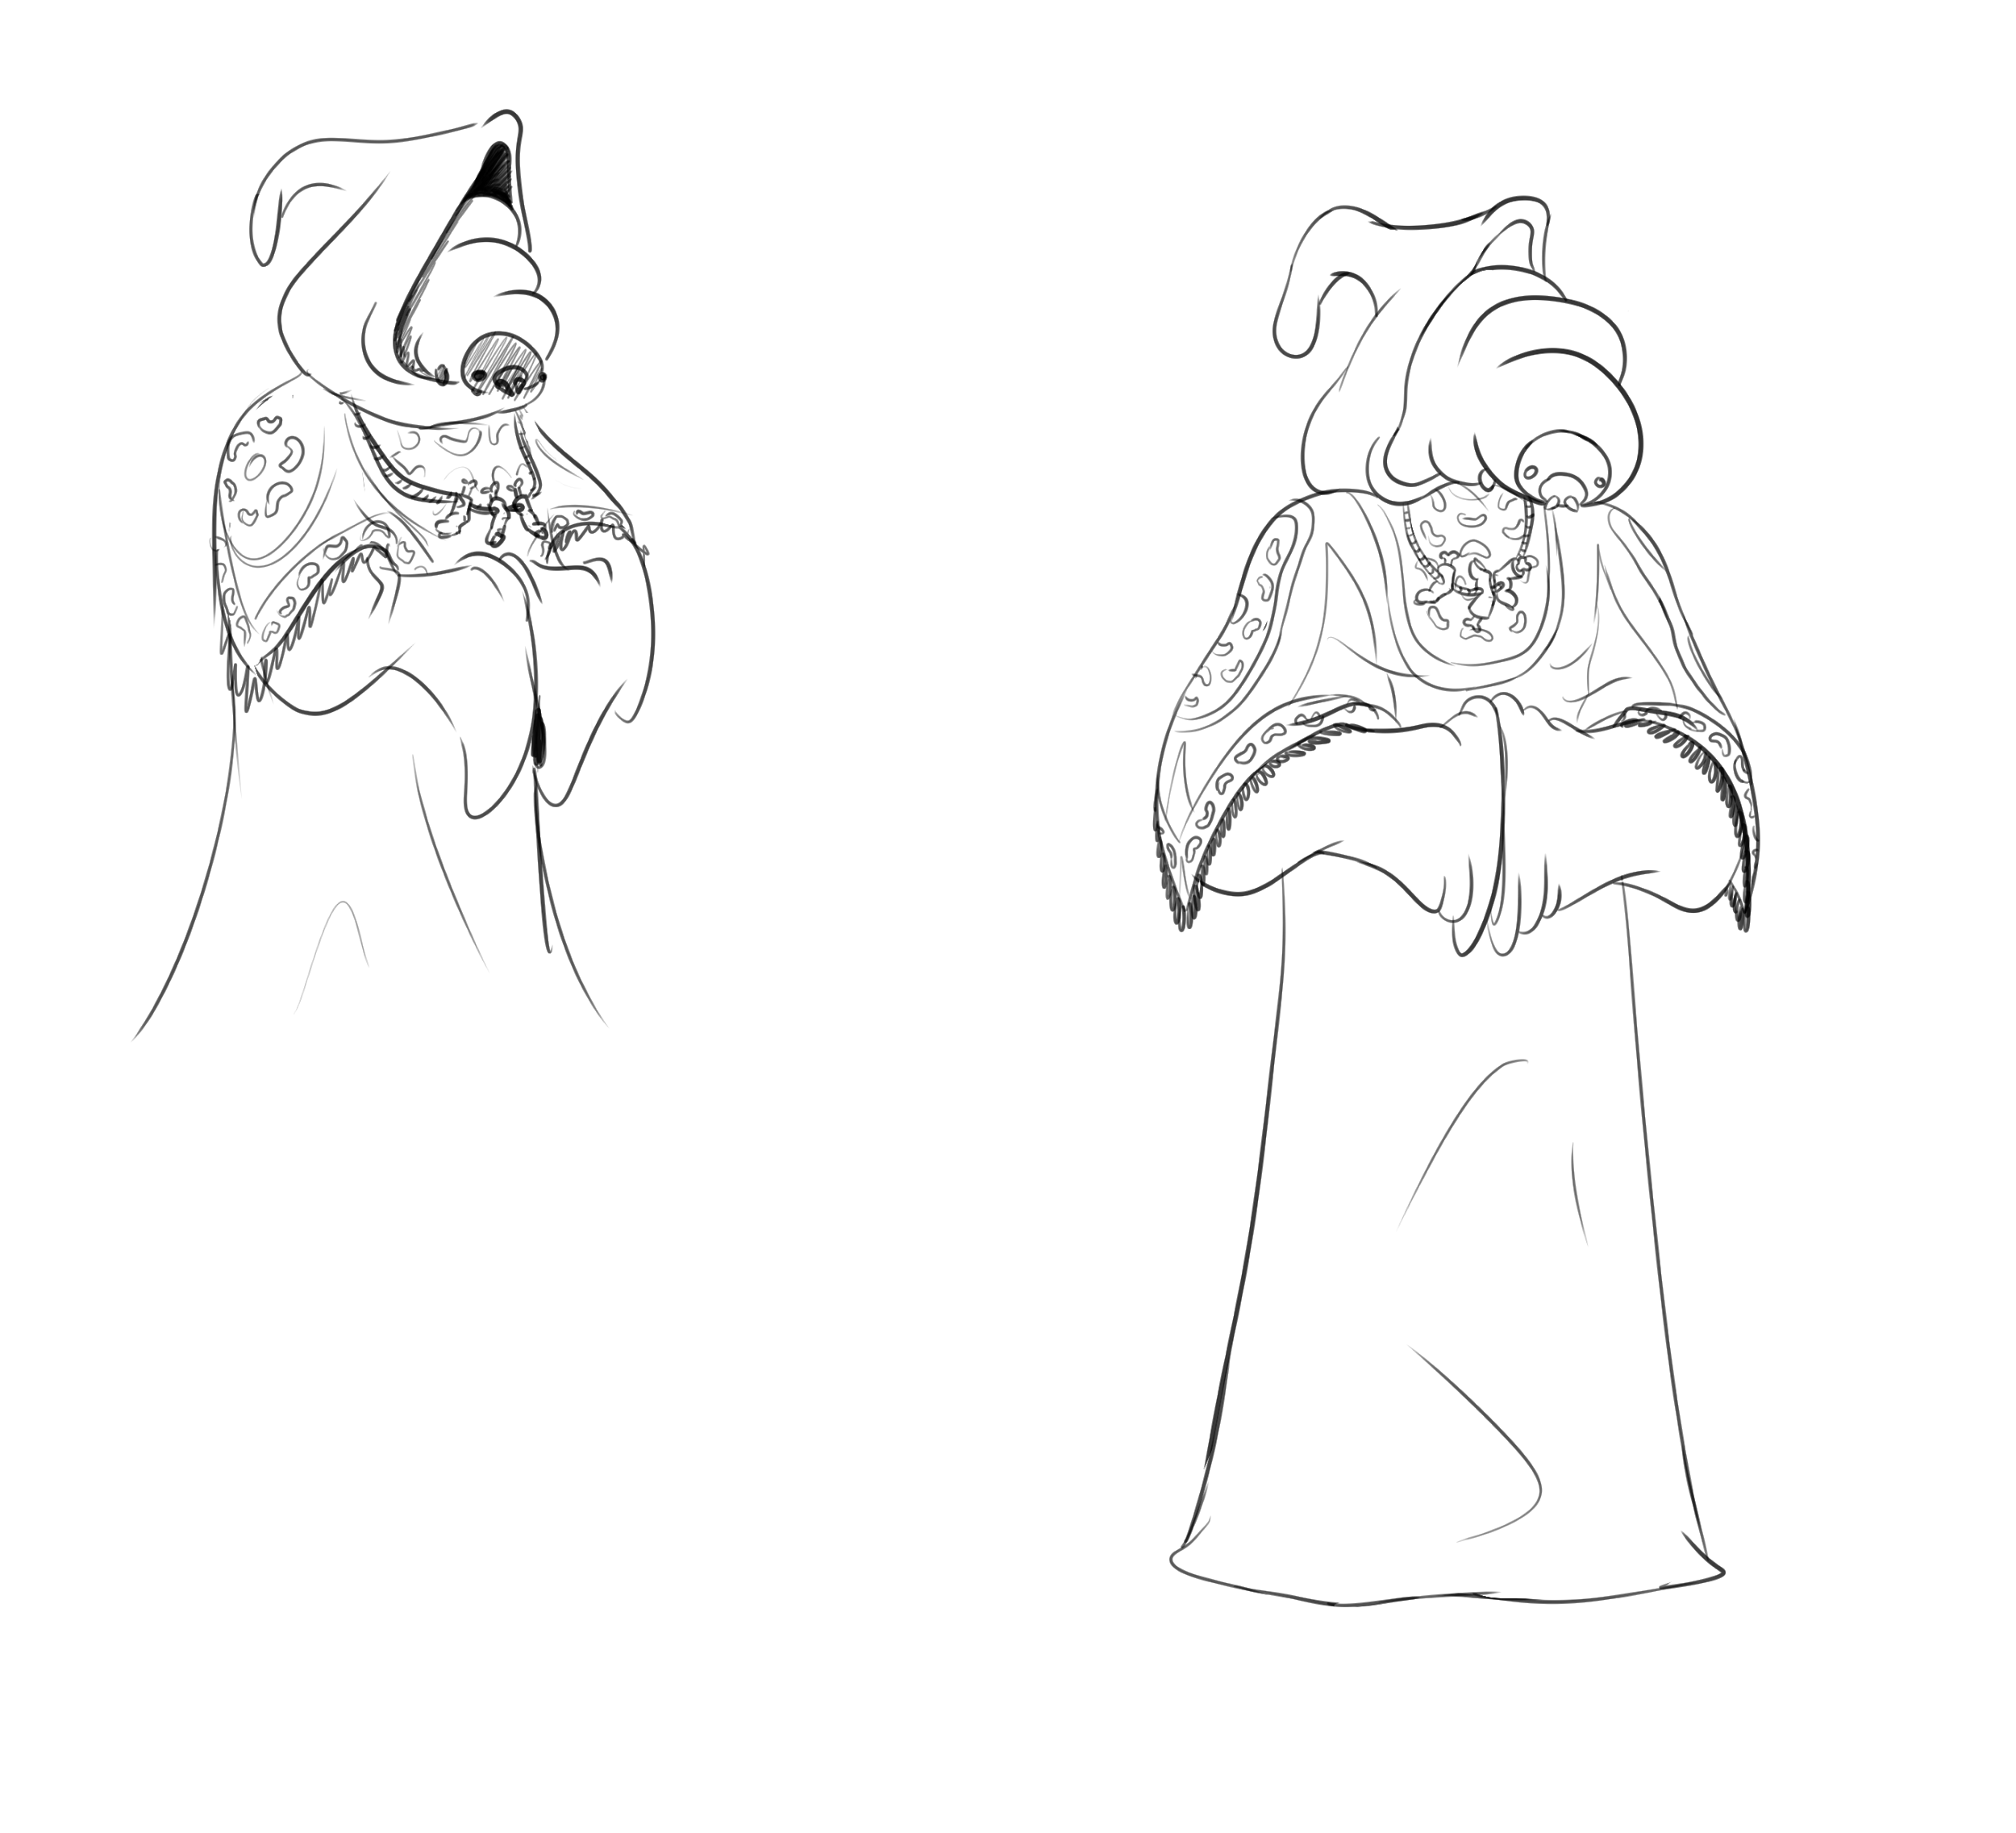
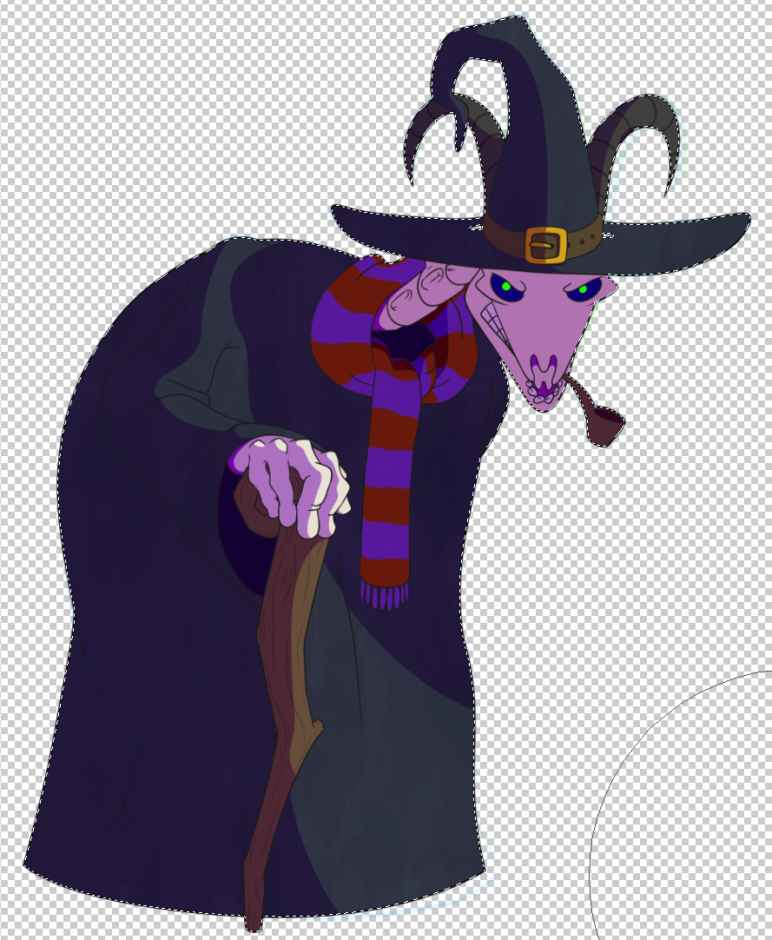
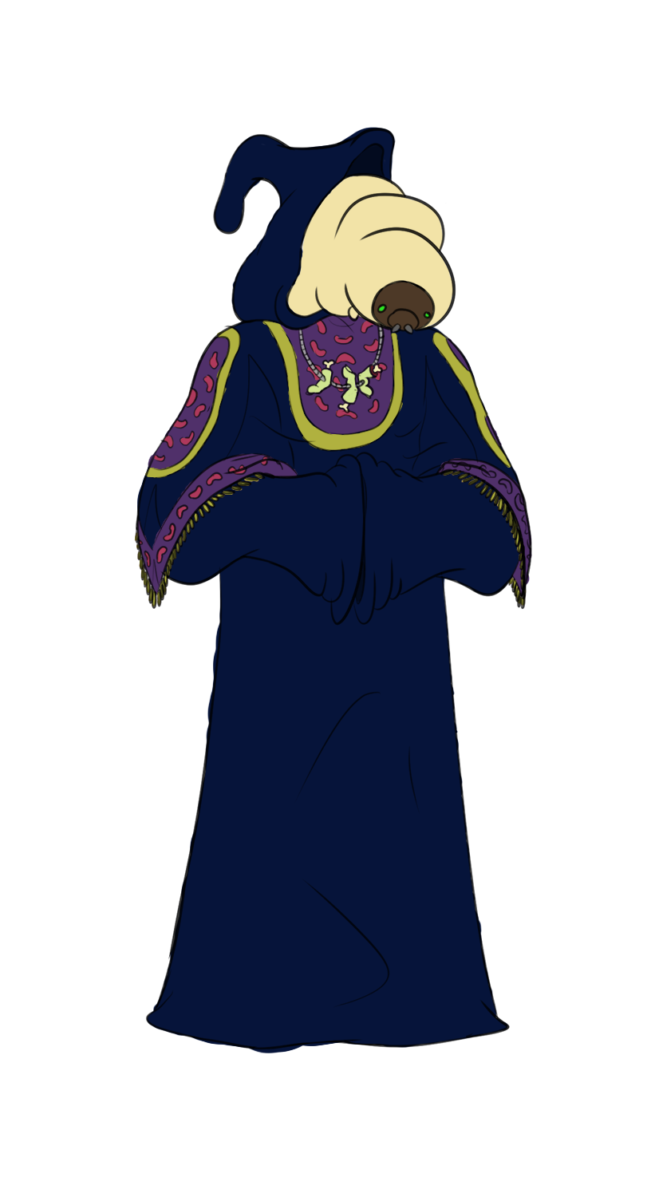
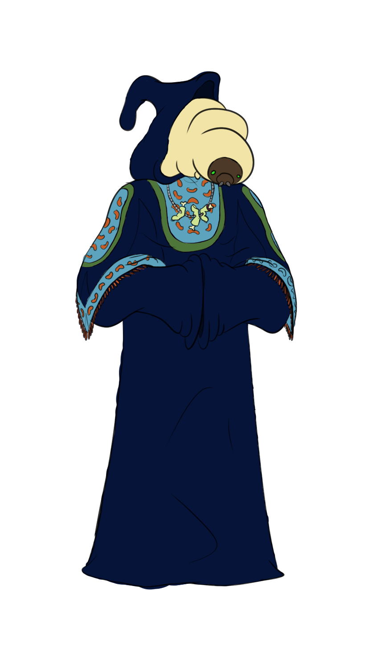
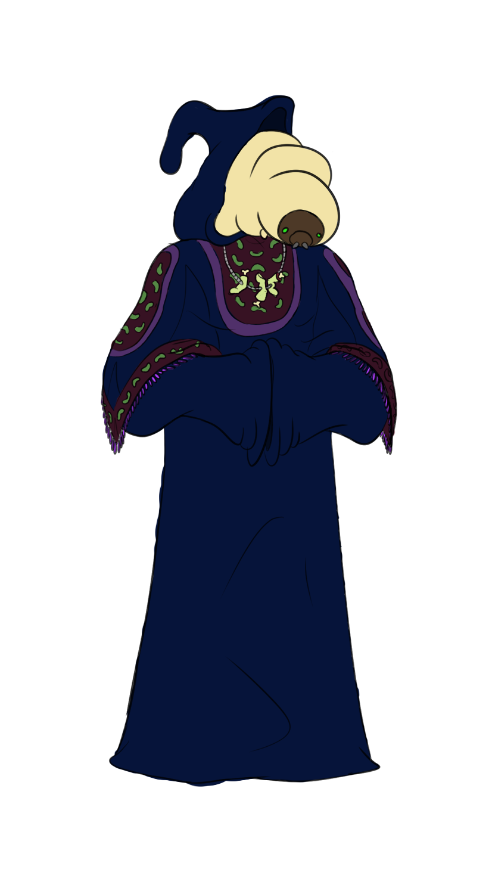
Mentor Palette Concepts
Final Merchant Concept
Elder Asset
WIP
Merchant Palette Concepts

Slide 6
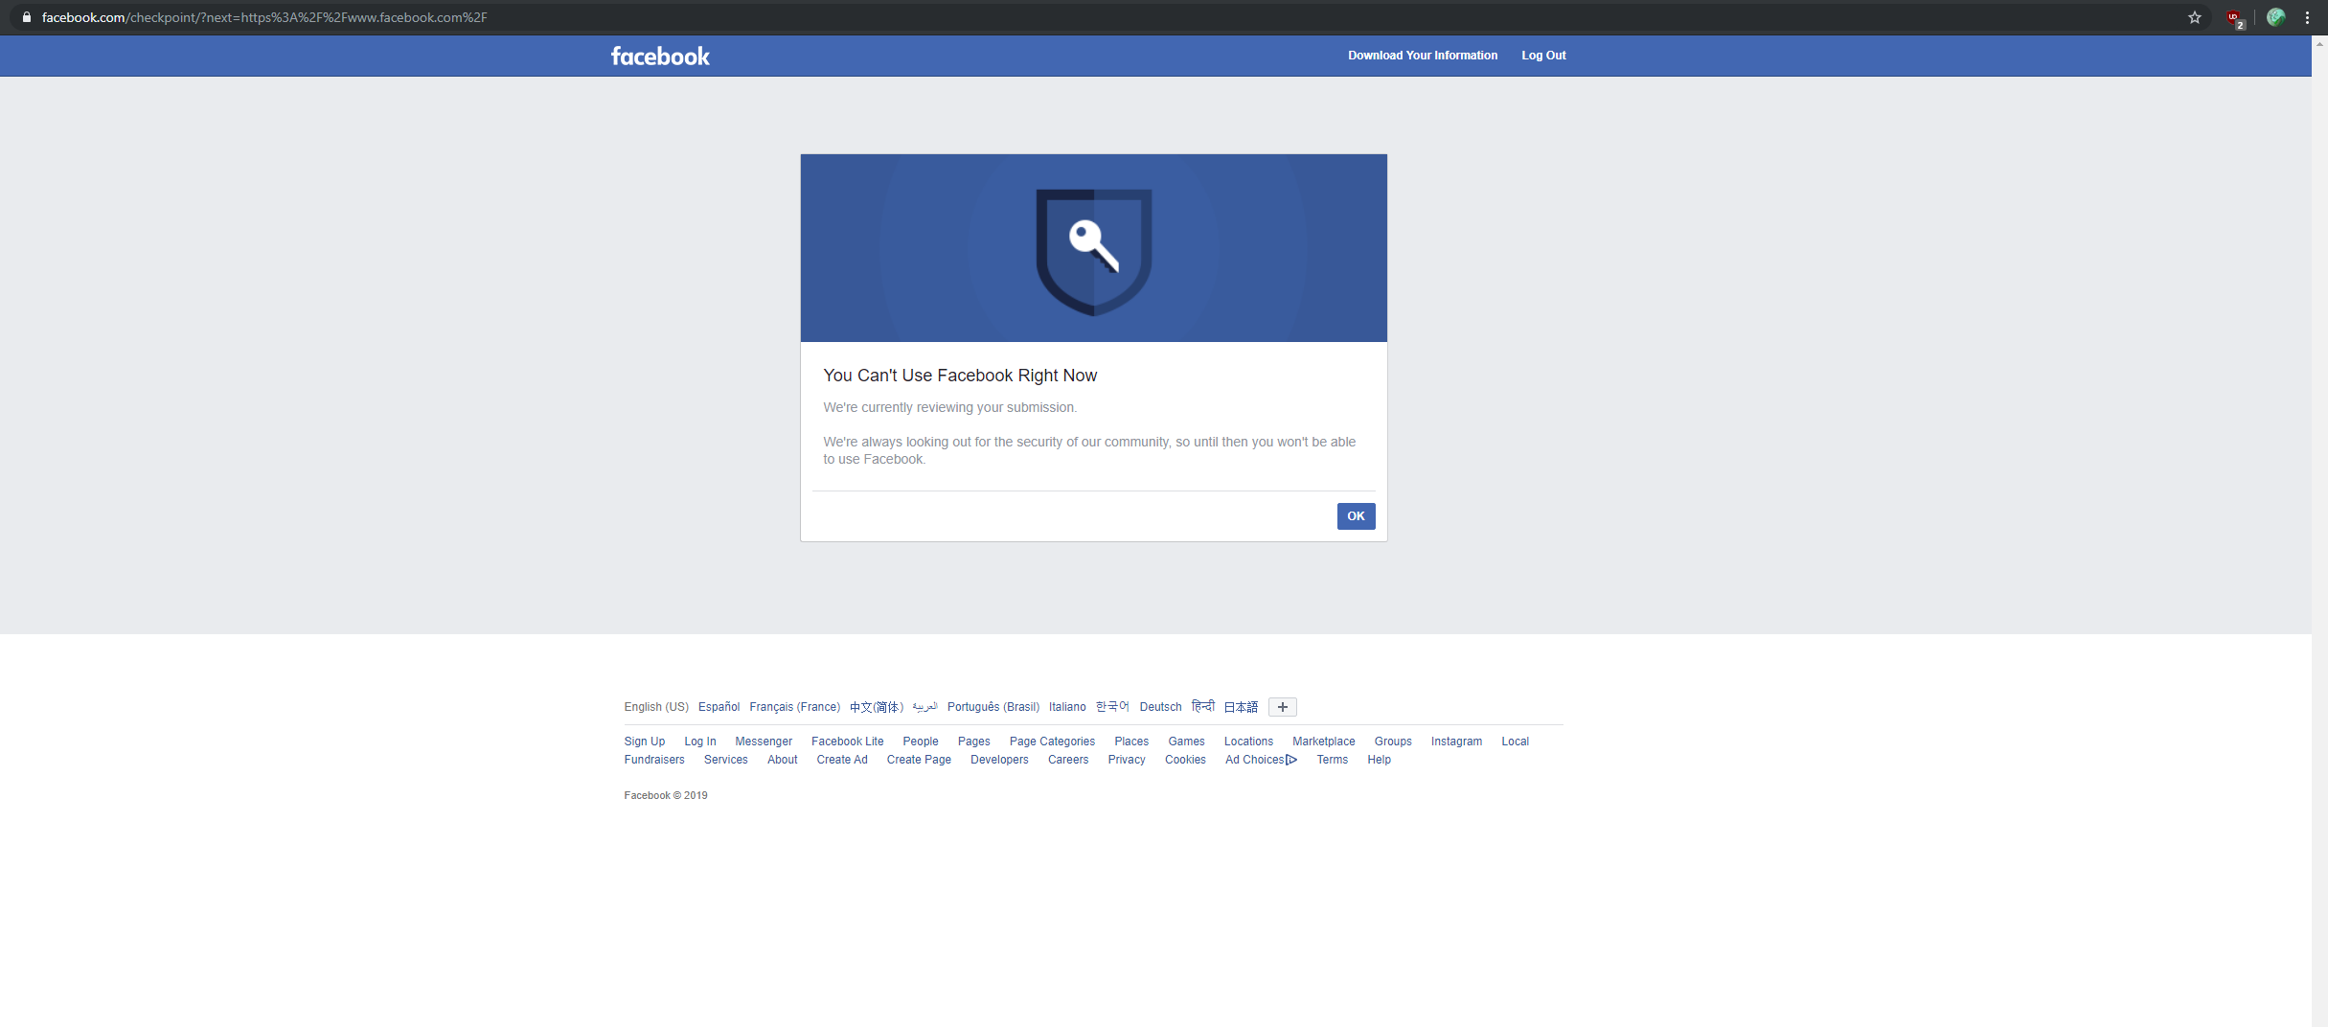

Marketing
Lol no
Send us a selfie, dumb idiot
*cough* https://twitter.com/NecroNursery *cough*

Slide 7
Programming
Morgue Minigame
Tap-to-start timer
Swipe-to-move GameObjects
Randomization of body parts / trash
Collecting required body parts
Grave / Monster Prefab
Plant Manager to hold resource information between scenes
Marketplace logic with randomization

Slide 8
What we plan to do!
Continue work on Graveyard Scene and Morgue Minigame
Start adding art assets into the game
Begin “full” playtesting once a playable build is created

Slide 9

Troubles along the way?
Been pretty smooth so far..

Slide 10
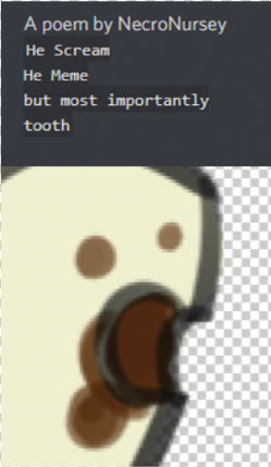
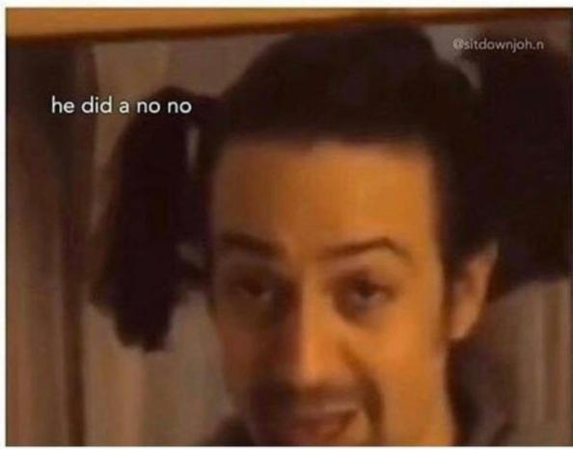
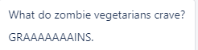
Questions?

